Slide 1


CytoAutoCluster: Revolutionizing Cytometry with Machine Learning
Presenter: Anuj Kadam

Slide 2
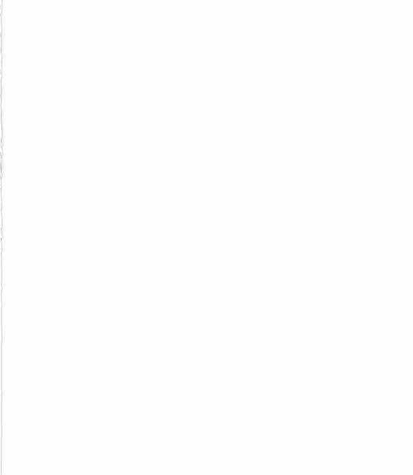
Project Background and Objective
Project Background and Objective
The Challenge: Cytometry data is complex, high-dimensional, and often noisy. Traditional clustering methods face limitations with scalability and interpretation.
Key Issue: A lack of sufficient labeled data makes supervised learning challenging, while biological variations add inconsistencies.
Objective: Create a semi-supervised model to enhance clustering accuracy and reduce dependency on manual annotations.
Approach: Use autoencoder-based methods to simplify data representation, validating against expert-labeled clusters.

Slide 3
Dataset Summary
Data Source: Levine_32dim dataset. Widely recognized in immunological research for benchmarking
Features: 32 biological markers capturing DNA, viability, and immune traits.
Labeling Distribution:
39%: Labeled into 14 clusters (104,184 samples).
61%: Unlabeled (161,443 samples).
Challenge: Handling high-dimensional data with a mix of labeled and unlabeled points.
Goal: Extract meaningful patterns while ensuring interpretability.

Slide 4
Workflow and Methods
Data Preparation
Feature scaling with standerdscaler
Splitting data into labeled and unlabeled subsets.
Dimensionality Reduction
Visualizing clusters in 2D using t-SNE.
Semi-Supervised Learning
Train autoencoders for feature extraction.
Balance tasks using combined loss (Binary Cross-Entropy & MSE).
Clustering
Use labeled data as a guide to improve cluster definition in unlabeled subsets.

Slide 5
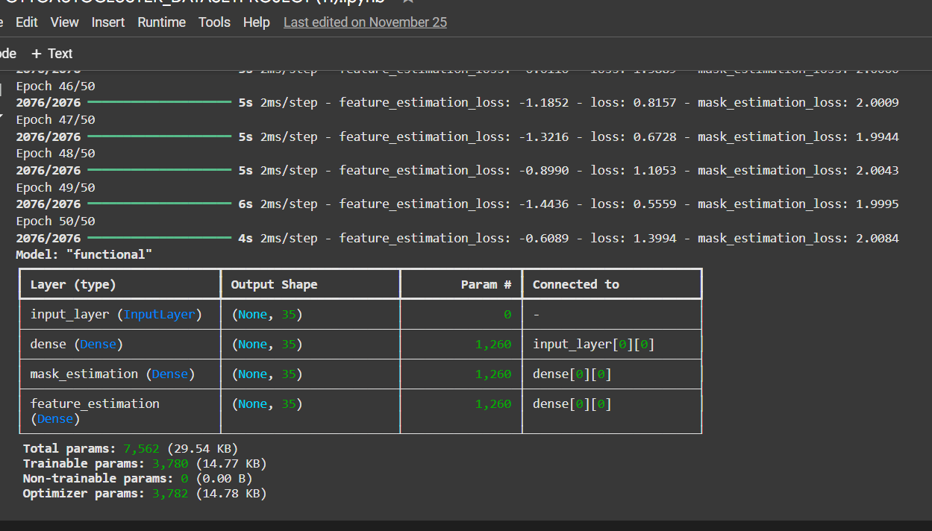
Model Overview
Architecture:
Encoder: Compresses data into a compact form.
Decoder: Reconstructs the original features.
Learning Paradigm:
Combines supervised learning with autoencoders for effective feature learning.
Outputs clusters with minimized reliance on manual intervention.

Slide 6
Results and Analysis
Performance:
Accuracy: 94.05%.
AUROC: 0.9987, showcasing excellent class separation.
Algorithms:
Logistic Regression: Low error (Log Loss: 0.022).
XGBoost: Robust predictions with slightly higher Log Loss (0.043).
t-SNE Visualizations:
Distinct clusters with minimal overlap, showcasing clarity in group assignments.

Slide 7
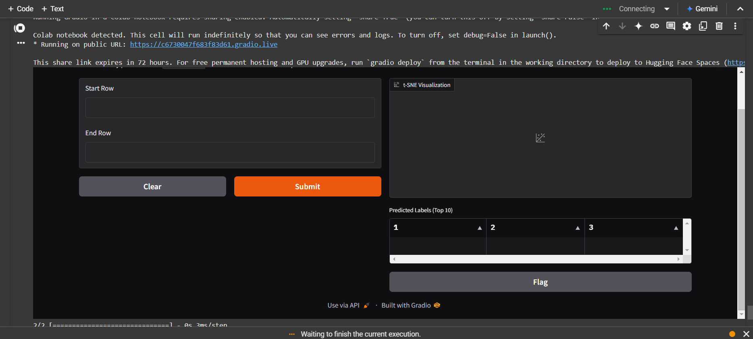
Demo of Gradio Interface

Slide 8
THANK YOU

